Slide 1
Bayesian Statistics using R
An Introduction
20 November 2011

Slide 2
Bayesian: one who asks you what you think before a study in order to tell you what you think afterwards
Adapted from:
S Senn (1997). Statistical Issues in Drug Development. Wiley

Slide 3
We Assume
Student knows Basic Probability Rules
Including Conditional Probability P(A | B) = P(A & B) / P(B)
And Bayes’ Theorem:
P( A | B ) = P( A ) × P( B | A ) ÷ P( B )
where
P( B ) = P( A )×P( B | A ) + P( A^{C} )×P( B | A^{C} )

Slide 4
We Assume
Student knows Basic Probability Models
Including Binomial, Poisson, Uniform, Normal
Could be familiar with t, Chi² & F
Preferably, but not necessarily, with Beta & Gamma Families
Preferably, but not necessarily, knows Basic Calculus

Slide 5
Bayesian [Laplacean] Methods
1763 – Bayes’ article on inverse probability
Laplace extended Bayesian ideas in different scientific areas in Théorie Analytique des Probabilités [1812]
Laplace & Gauss used the inverse method
1st three quarters of 20th Century dominated by frequentist methods [Fisher, Neyman, et al.]
Last quarter of 20th Century – resurgence of Bayesian methods [computational advances]
21st Century – Bayesian Century [Lindley]

Slide 6

Rev. Thomas Bayes
English Theologian and Mathematician
c. 1700 – 1761

Slide 7
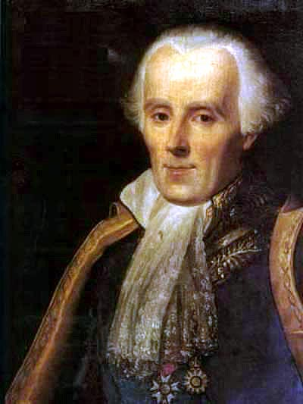
Pierre-Simon Laplace
French Mathematician
1749 – 1827

Slide 8
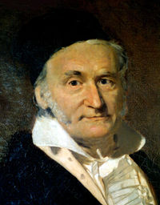
Karl Friedrich Gauss
“Prince of Mathematics”
1777 – 1855

Slide 9
Bayes’ Theorem
Basic tool of Bayesian analysis
Provide the means by which we learn from data
Given prior state of knowledge, it tells how to update belief based upon observations:
P(H | Data) = P(H) · P(Data | H) / P(Data)
P(H) · P(Data | H)

Slide 10
Bayes’ Theorem
Can also consider posterior probability of any measure θ:
P(θ | data)  P(θ) · P( data | θ)
Bayes’ theorem states that the posterior probability of any measure θ, is proportional to the information on θ external to the experiment times the likelihood function evaluated at θ:
Prior · likelihood → posterior

Slide 11
Prior
Prior information about θ assessed as a probability distribution on θ
Distribution on θ depends on the assessor: it is subjective
A subjective probability can be calculated any time a person has an opinion
Diffuse (Vague) prior - when a person’ s opinion on θ includes a broad range of possibilities & all values are thought to be roughly equally probable

Slide 12
Prior
Conjugate prior – if the posterior distribution has same shape as the prior distribution, regardless of the observed sample values
Examples:
  Beta prior & binomial likelihood yield a beta posterior
  Normal prior & normal likelihood yield a normal posterior
  Gamma prior & Poisson likelihood yield a gamma posterior

Slide 13
Community of Priors
Expressing a range of reasonable opinions
Reference – represents minimal prior information [JM Bernardo, U of V]
Expertise – formalizes opinion of well-informed experts
Skeptical – downgrades superiority of new treatment
Enthusiastic – counterbalance of skeptical

Slide 14
Likelihood Function
P(data | θ)
Represents the weighting of evidence from the experiment about θ
It states what the experiment says about the measure of interest [ LJ Savage, 1962 ]
It is the probability of getting certain result, conditioning on the model
Prior is dominated by the likelihood as the amount of data increases:
  Two investigators with different prior opinions could reach a consensus after the results of an experiment

Slide 15
Likelihood Principle
States that the likelihood function contains all relevant information from the data
Two samples have equivalent information if their likelihoods are proportional
Adherence to the Likelihood Principle means that inference are conditional on the observed data
Bayesian analysts base all inferences about θ solely on its posterior distribution
Data only affect the posterior through the likelihood P(data | θ)

Slide 16
Likelihood Principle
Two experiments: one yields data y₁ and the other yields data y₂
If the likelihoods: P(y₁ | θ) & P(y₂ | θ) are identical up to multiplication by arbitrary functions of y₁ & y₂ then they contain identical information about θ and lead to identical posterior distributions
Therefore, to equivalent inferences

Slide 17
Example
EXP 1: In a study of a fixed sample of 20 students, 12 of them respond positively to the method [Binomial distribution]
Likelihood is proportional to
θ¹² (1 – θ)⁸
EXP 2: Students are entered into a study until 12 of them respond positively to the method [Negative-binomial distribution]
Likelihood at n = 20 is proportional to
θ¹² (1 – θ)⁸

Slide 18
Exchangeability
  Key idea in statistical inference in general
  Two observations are exchangeable if they provide equivalent statistical information
  Two students randomly selected from a particular population of students can be considered exchangeable
  If the students in a study are exchangeable with the students in the population for which the method is intended, then the study can be used to make inferences about the entire population
  Exchangeability in terms of experiments: Two studies are exchangeable if they provide equivalent statistical information about some super-population of experiments

Slide 19
Bayesian Estimation of θ
X successes & Y failures, N independent trials
Prior Beta(a, b) x Binomial likelihood → Posterior Beta(a + x, b + y)
Example in:
Suárez, Pérez & Guzmán. “Métodos Alternos de Análisis Estadístico en Epidemiología”. PR Health Sciences Journal. 19(2), June, 2000

Slide 20
Bayesian Estimation of θ
a = 1; b = 1
prob.p = seq(0, 1, .1)
prior.d = dbeta(prob.p, a, b)

Slide 21
Prior Density Plot
plot(prob.p, prior.d, type = "l", main="Prior Density for P", xlab="Proportion", ylab="Prior Density")
Observed 8 successes & 12 failures
x = 8; y = 12; n = x + y

Slide 22
Likelihood & Posterior
like = prob.p^x * (1-prob.p)^y
post.d0 = prior.d * like
post.d = dbeta(prob.p, a + x , b + y) # Beta Posterior

Slide 23
Posterior Distribution
plot(prob.p, post.d, type="l", main = "Posterior Density for θ", xlab = "Proportion", ylab = "Posterior Density")
Get better plots using library(Bolstad)
Install library(Bolstad) from CRAN

Slide 24
# 8 successes observed in 20 trials with a Beta(1, 1) prior
library(Bolstad)
results = binobp(8, 20, 1, 1, ret = TRUE)
par(mfrow = c(3, 1))
y.lims=c(0, 1.1*max(results$posterior, results$prior))
plot(results$theta, results$prior, ylim=y.lims, type="l",
xlab=expression(theta), ylab="Density", main="Prior")
polygon(results$theta, results$prior, col="red")
plot(results$theta, results$likelihood, ylim=c(0,0.25), type="l",
xlab=expression(theta), ylab="Density", main="Likelihood")
polygon(results$theta, results$likelihood, col="green")
plot(results$theta, results$posterior, ylim=y.lims, type="l",
xlab=expression(theta), ylab="Density", main="Posterior")
polygon(results$theta, results$posterior, col="blue")
par(mfrow = c(1, 1))

Slide 25
Posterior Inference
Results :
Posterior Mean : 0.4090909
Posterior Variance : 0.0105102
Posterior Std. Deviation : 0.1025195
Prob. Quantile
------ ---------
0.005 0.1706707
0.01 0.1891227
0.025 0.2181969
0.05 0.2449944
0.5 0.4062879
0.95 0.5828013
0.975 0.6156456
0.99 0.65276
0.995 0.6772251

Slide 26
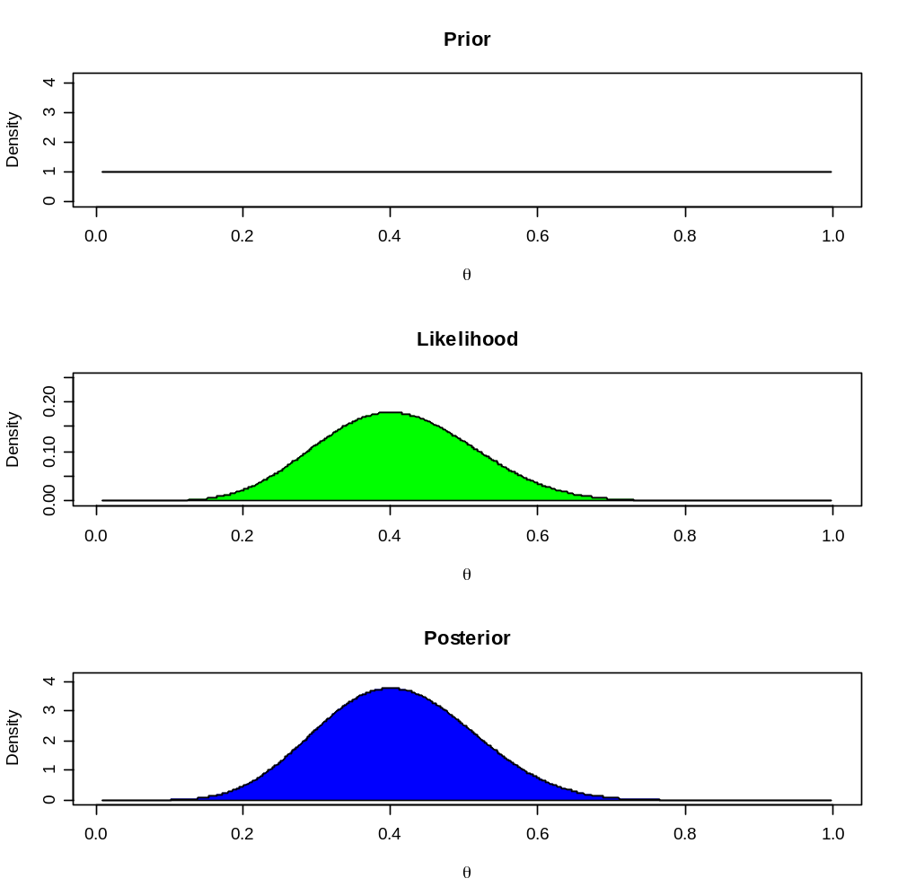

Slide 27
Credible Interval
Generate 1000 random observations from beta(a + x , b + y)
set.seed(12345)
x.obs = rbeta(1000, a + x , b + y)

Slide 28
Mean & 90% Posterior Limits for P
Obtain a 90% credible limits:
q.obs.low = quantile(x.obs, p = 0.05) # 5th percentile
q.obs.hgh = quantile(x.obs, p = 0.95) # 95th percentile
print(c(q.obs.low, mean(x.obs), q.obs.hgh))

Slide 29
Example: Beta-Binomial
Posterior distributions for a set of four different prior distributions
Ref: Horton NJ et al. Use of R as a toolbox for mathematical statistics ...
American Statistician, 58(4), Nov. 2004: 343-357

Slide 30
Example: Beta-Binomial
N = 50
set.seed(42)
Y = sample(c(0,1), N, pr=c(.2, .8), replace = T)
postbetbin = function(p, Y, N, alpha, beta) {
return(dbinom(sum(Y), N, p)*dbeta(p, alpha, beta))
}

Slide 31
Example: Beta-Binomial
lbinom = function(p,Y,N) dbinom(Y,N,p)
dbeta2 = function(ab, p) return(unlist(lapply(p, dbeta,shape = ab[1], shape2 = ab[2])))
lines2 = function(y,x,...) lines(x,y[-1], lty=y[1],...)

Slide 32
Example: Beta-Binomial
x = seq(0,1,l=200)
alphabeta=matrix(0, nrow=4, ncol=2)
alphabeta[1,]=c(1,1)
alphabeta[2,]=c(60,60)
alphabeta[3,]=c(5,5)
alphabeta[4,]=c(2,5)
labs=c("beta(1,1)","beta(60,60)", "beta(5,5)", "beta(2,5)")
priors=apply(alphabeta, 1, dbeta2, p=x)

Slide 33
Example: Beta-Binomial
par(mfrow=c(2,2), lwd=2,mar=rep(3,4), cex.axis=.6)
for(j in 1:4) {
plot(x, unlist(lapply(x, lbinom, Y =sum(Y), N=N)), type="l",
xlab="p", col="gray", ylab="", main=paste("Prior is", labs[j]),
ylim=c(0,.3))
lines(x, unlist(lapply(x, postbetbin, Y=sum(Y), N=N,
alpha=alphabeta[j,1], beta=alphabeta[j,2])), lty=1)
par(new=T)

Slide 34
Example: Beta-Binomial
plot(x, dbeta(x, alphabeta[j,1], alphabeta[j,2]), lty=3, axes=F, type='l', xlab="", ylab="", ylim=c(0,9))
axis(4)
legend(0,9, legend=c("Prior", "Likelihood", "Posterior"), lty=c(3,1,1), col=c("black","gray", "black"), cex=.6)
mtext("Prior", side=4, outer=F, line=2, cex=.6)
mtext("Likelihood/Posterior", side=2, outer=F, line=2, cex=.6)
}

Slide 35
Bayesian Inference: Normal Mean
Bayesian inference on a normal mean with a normal prior
Bayes’ Theorem:
Prior x Likelihood → Posterior
Assume sd is known:
If y ~ N(mu, sd); mu ~ N(m0, sd0)
→ mu | y ~ N(m1, sd1)
Data: y1, y2, …, yn

Slide 36
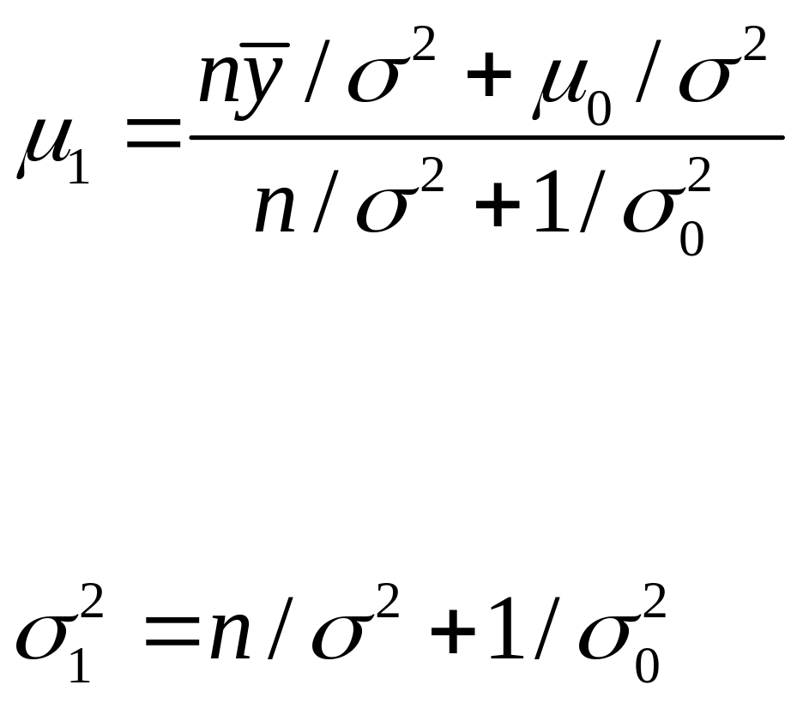
Posterior Mean & SD

Slide 37
Examples Using Bolstad Library
Example 1: Generate a sample of 20 observations from a N(-0.5 , sd=1) population
library(Bolstad)
set.seed(1234)
y = rnorm(20, -0.5, 1)
Find posterior density with a N(0, 1) prior on mu
normnp(y,1)

Slide 38
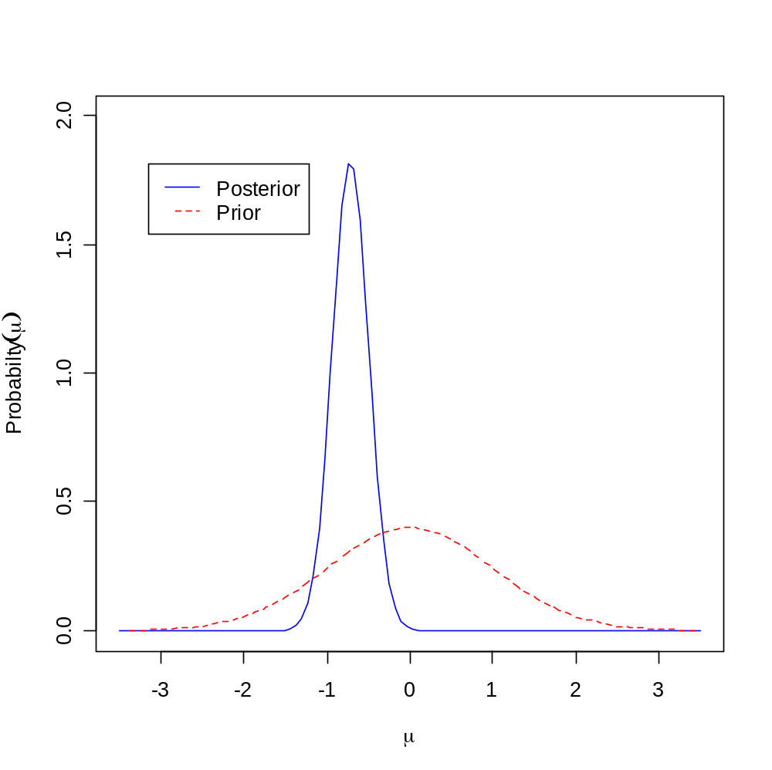

Slide 39
Examples Using Bolstad Library
Example 2: Find the posterior density with N(0.5, 3) prior on mu
normnp(y, 1, 0.5, 3)

Slide 40
Examples Using Bolstad Library
Example 3: y ~ N(mu,sd=1) and y = [2.99, 5.56, 2.83, 3.47]
Prior: mu ~ N(3, sd=2)
y = c(2.99,5.56,2.83,3.47)
normnp(y, 1, 3, 2)

Slide 41
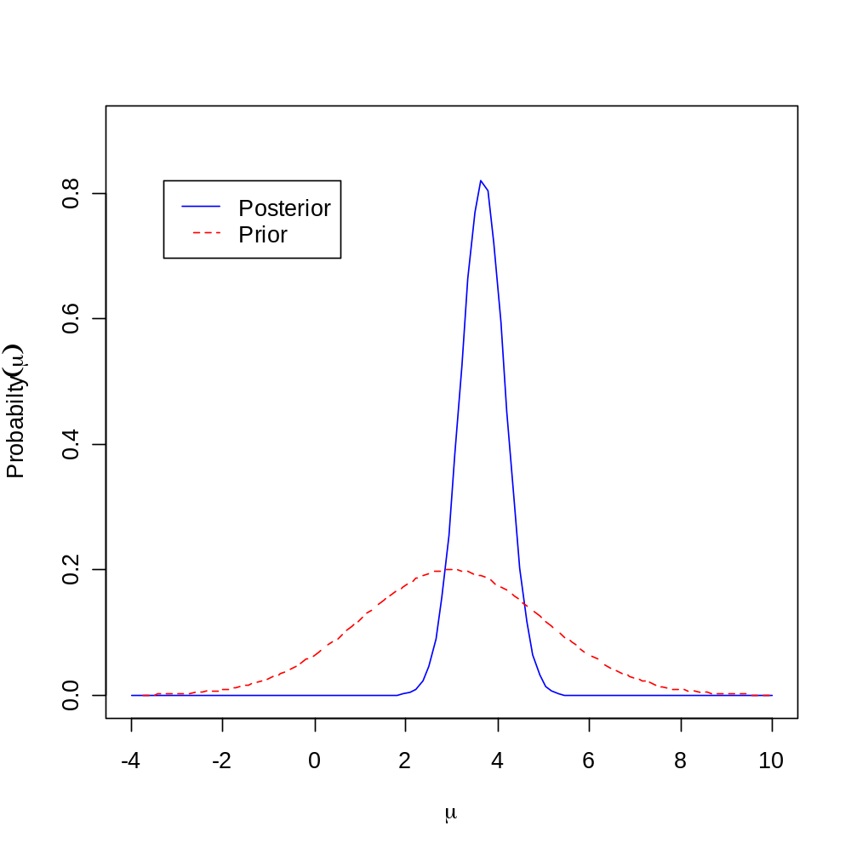

Slide 42
Inference on a Normal Mean with a General Continuous Prior
normgcp {Bolstad}
Evaluates and plots the posterior density for mu, the mean of a normal distribution
Use a general continuous prior on mu

Slide 43
Examples
Ex 1: Generate a sample of 20 observations from N(-0.5 , sd=1)
set.seed(9876)
y = rnorm(20, -0.5, 1)
Find the posterior density with a uniform U[-3, 3] prior on mu
normgcp(y, 1, params = c(-3,3))

Slide 44
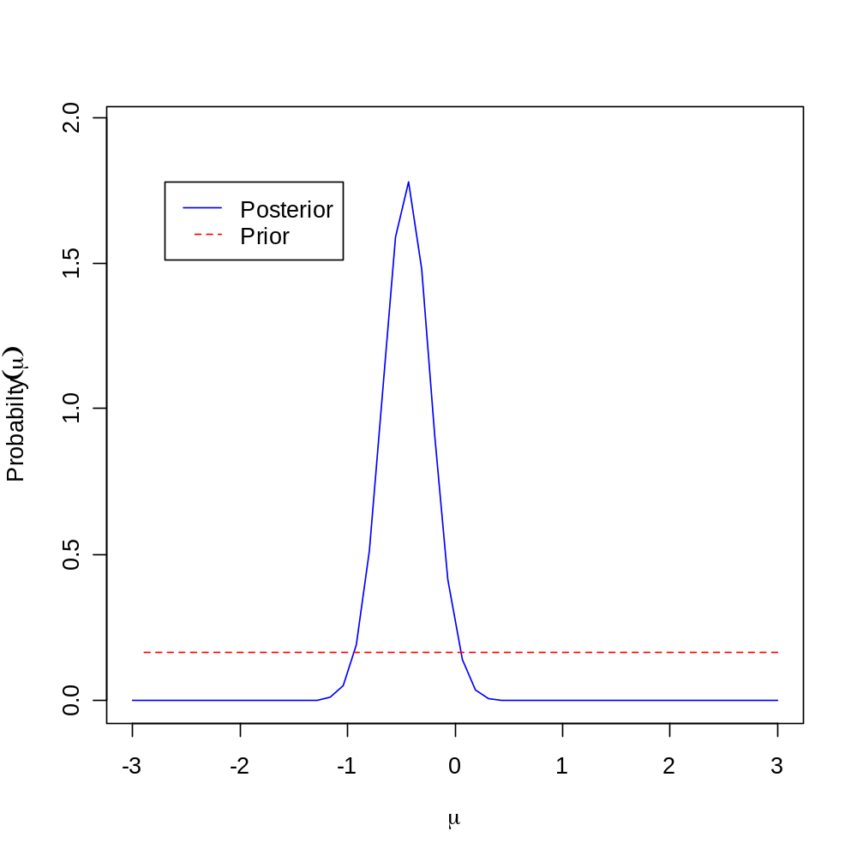

Slide 45
Examples
Ex 2: Find the posterior density with a non-uniform prior on mu
mu = seq(-3, 3, by = 0.1)
mu.prior = rep(0,length(mu))
mu.prior[mu<=0] = 1/3 + mu[mu<=0]/9
mu.prior[mu>0] = 1/3 - mu[mu>0]/9
normgcp(y,1, density = "user", mu = mu, mu.prior = mu.prior)

Slide 46
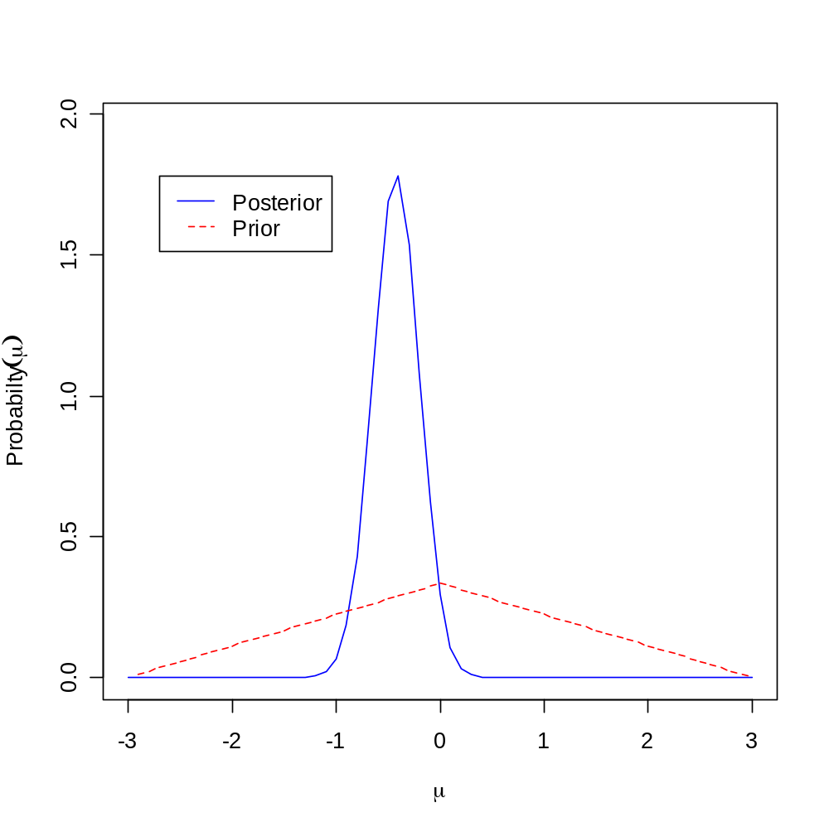

Slide 47
Hierarchical Models
Data from several subpopulations or groups
Instead of performing separate analyses for each group, it may make good sense to assume that there is some relationship between the parameters of different groups
Assume exchangeability between groups & introduce a higher level of randomness on the parameters
Meta-analysis approach - particularly effective when the information from each sub-population is limited

Slide 48
Hierarchical Models
Hierachical modeling also includes:
Mixed-effects models
Variance component models
Continuous mixture models

Slide 49
Hierarchical Modeling
Eight Schools Example
ETS Study – analyze effects of coaching program on test scores
Randomized experiments to estimate effect of coaching for SAT-V in high schools
Details – Gelman et al. B D A
Solution with R package BRugs

Slide 50
Eight Schools Example
Sch | A | B | C | D | E | F | G | H
TrEf y_{j} | 28 | 8 | -3 | 7 | -1 | 1 | 18 | 12
StdEr s_{j} | 15 | 10 | 16 | 11 | 9 | 11 | 10 | 18

Slide 51
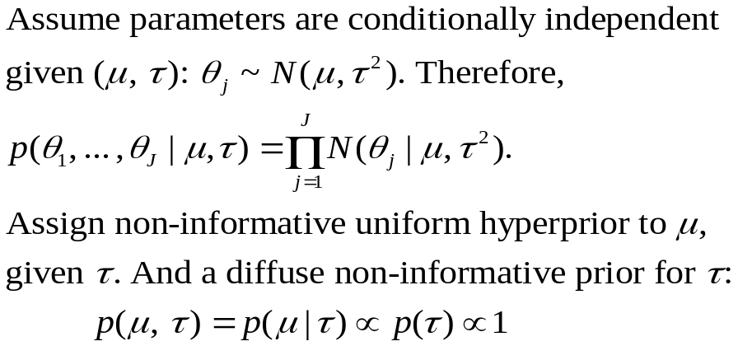
Hierarchical Modeling

Slide 52
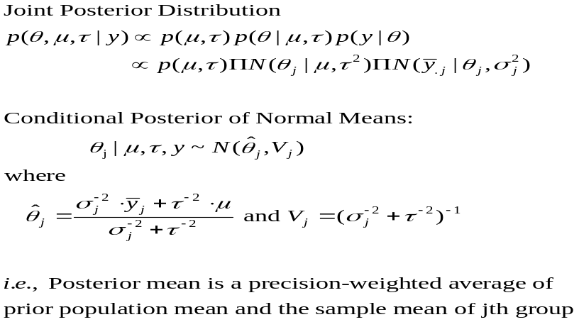
Hierarchical Modeling

Slide 53
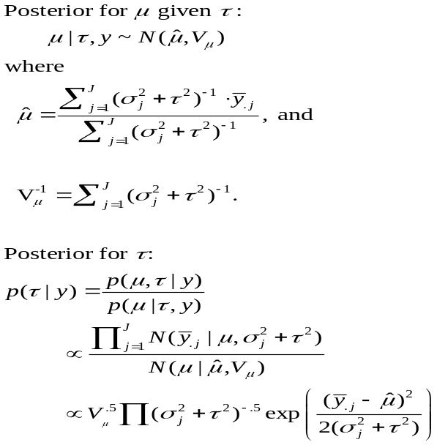
Hierarchical Modeling

Slide 54
Using R BRugs
# Use File > Change dir ... to find required folder
# school.wd="C:/Documents and Settings/Josue Guzman/My Documents/R Project/My Projects/Bayesian/W_BUGS/Schools"
library(BRugs) # Load Brugs package
modelCheck("SchoolsBugs.txt") # HB Model
modelData("SchoolsData.txt") # Data
nChains=1
modelCompile(numChains=nChains)
modelInits(rep("SchoolsInits.txt",nChains))
modelUpdate(1000) # Burn in
samplesSet(c("theta","mu.theta","sigma.theta"))
dicSet()
modelUpdate(10000,thin=10)
samplesStats("*")
dicStats()
plotDensity("mu.theta",las=1)

Slide 55
Schools’ Model
model {
for (j in 1:J)
{
y[j] ~ dnorm (theta[j], tau.y[j])
theta[j] ~ dnorm (mu.theta, tau.theta)
tau.y[j] <- pow(sigma.y[j], -2)
}
mu.theta ~ dnorm (0.0, 1.0E-6)
tau.theta <- pow(sigma.theta, -2)
sigma.theta ~ dunif (0, 1000)
}

Slide 56
Schools’ Data
list(J=8, y = c(28.39, 7.94, -2.75, 6.82, -0.64, 0.63, 18.01, 12.16),
sigma.y = c(14.9, 10.2, 16.3, 11.0, 9.4, 11.4, 10.4, 17.6))

Slide 57
Schools’ Initial Values
list(theta = c(0, 0, 0, 0, 0, 0, 0, 0),
mu.theta = 0,
sigma.theta = 50) )

Slide 58
BRugs Results
samplesStats("*")
mean sd MCerror 2.5pc median 97.5pc start sample
mu.theta 8.147 5.28 0.081 -2.20 8.145 18.75 1001 10000
sigma.theta 6.502 5.79 0.100 0.20 5.107 21.23 1001 10000
theta[1] 11.490 8.28 0.098 -2.34 10.470 31.23 1001 10000
theta[2] 8.043 6.41 0.091 -4.86 8.064 21.05 1001 10000
theta[3] 6.472 7.82 0.103 -10.76 6.891 21.01 1001 10000
theta[4] 7.822 6.68 0.079 -5.84 7.778 21.18 1001 10000
theta[5] 5.638 6.45 0.091 -8.51 6.029 17.15 1001 10000
theta[6] 6.290 6.87 0.087 -8.89 6.660 18.89 1001 10000
theta[7] 10.730 6.79 0.088 -1.35 10.210 25.77 1001 10000
theta[8] 8.565 7.87 0.102 -7.17 8.373 25.32 1001 10000

Slide 59
Graphical Display
plotDensity("mu.theta",las=1, main = "Treatment Effect")
plotDensity("sigma.theta",las=1, main = "Standard Error")
plotDensity("theta[1]",las=1, main = "School A")
plotDensity("theta[3]",las=1, main = "School C")
plotDensity("theta[8]",las=1, main = "School H")

Slide 60
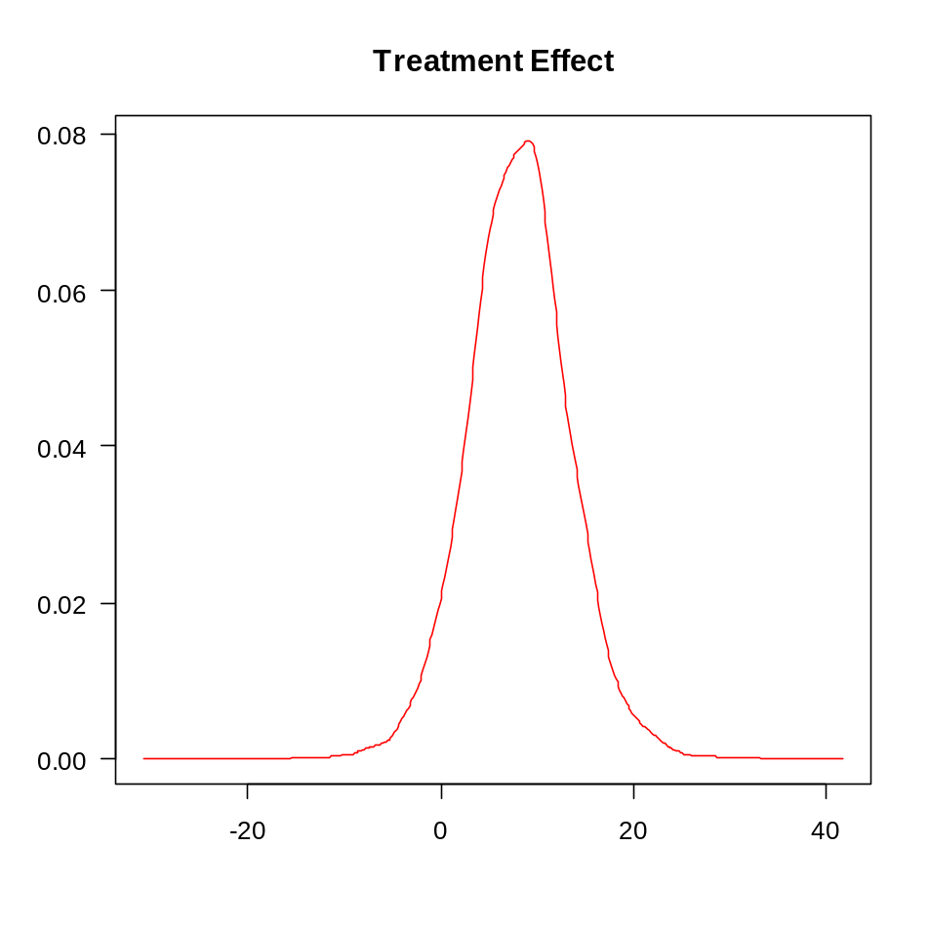
Graphical Display

Slide 61
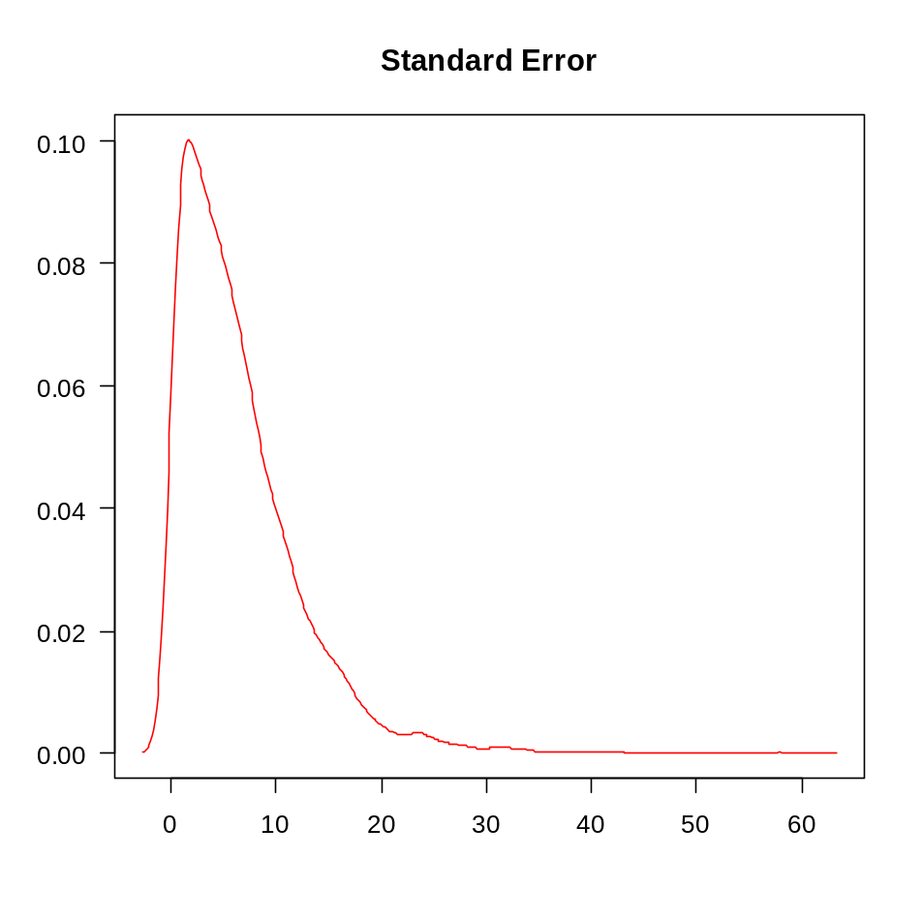
Graphical Display

Slide 62
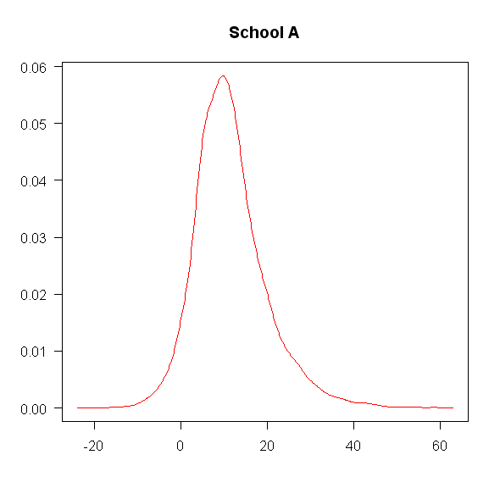
Graphical Display

Slide 63
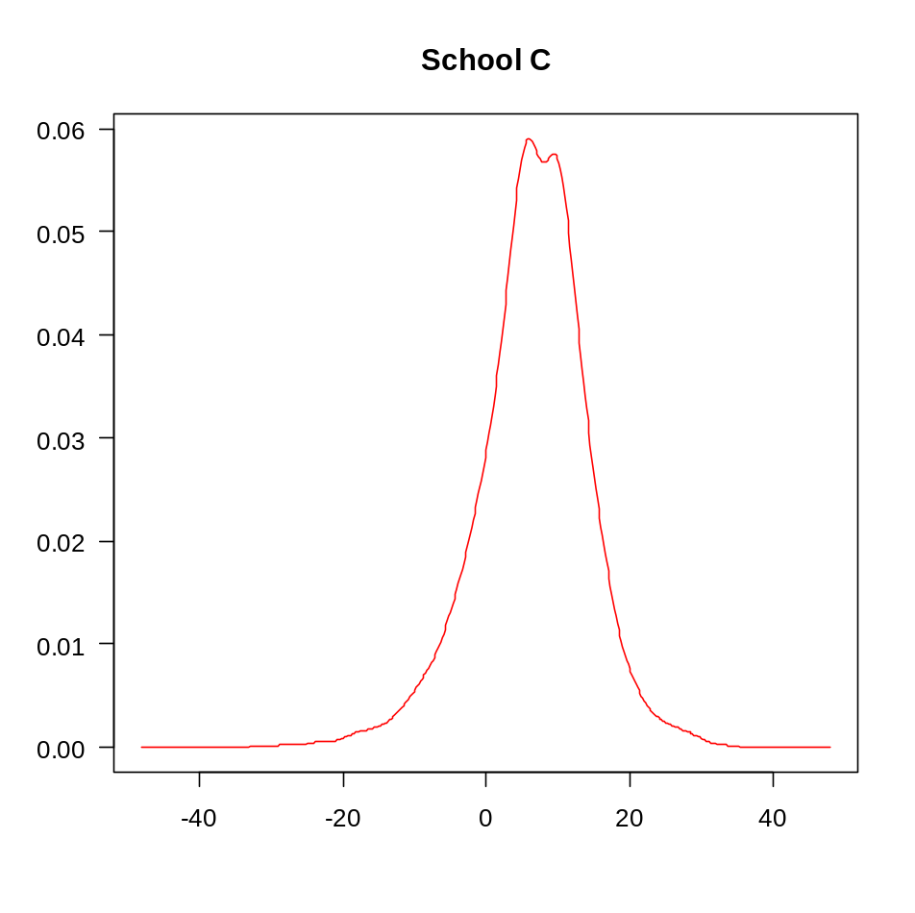
Graphical Display

Slide 64
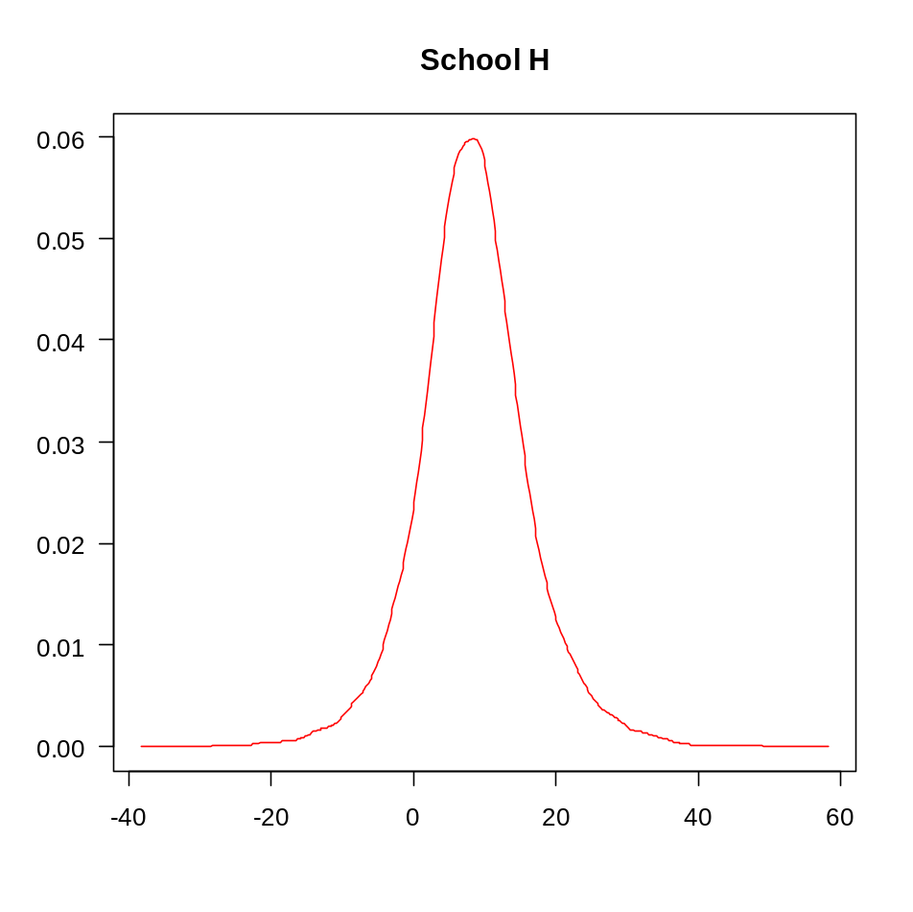
Graphical Display

Slide 65
Some Useful References
Bolstad WM. Introduction to Bayesian Statistics. Wiley, 2004.
Gelman A, GO Carlin, HS Stern & DB Rubin. Bayesian Data Analysis, Second Edition. Chapman-Hall, 2004.
Lee P. Bayesian Statistics: An Introduction, Second Edition. Arnold, 1997.
Rossi PE, GM Allenby & R McCulloch. Bayesian Statistics and Marketing. Wiley, 2005.

Slide 66
Laplace on Probability
It is remarkable that a science, which commenced with the consideration of games of chance, should be elevated to the rank of the most important subjects of human knowledge.
A Philosophical Essay on Probabilities. John Wiley & Sons, 1902, page 195.
Original French edition 1814

